Slide 1
The 'world's first' AI news anchor has gone live in China

Slide 2
Amazon is releasing a $400 self-driving toy car that you can program yourself – and it's launching a racing league to test your skills
AWS DeepRacer: A remote controlled car, retailing for $400 when it becomes available next year, that developers can program to drive itself. This car is now available to pre-order on Amazon at a special introductory price of $249.
This radio-controlled, four-wheel drive vehicle is 1/18th the size of an actual car. It's trained using reinforcement learning, an AI technique that means the car will learn to drive better through trial and error. The car is rewarded for staying on the track, avoiding obstacles and more, helping the car to learn to drive more accurately over time.
This car uses an Intel Atom processor, and a 4 megapixel camera with 1080p resolution that has a heat map to detect obstacles, and WiFi access.

Slide 3
Generative adversarial network produces a "universal fingerprint" that will unlock many smartphones

Slide 4
NO TIME TO READ AI RESEARCH? WE SUMMARIZED TOP 2018 PAPERS FOR YOU
Posted by Mariya Yao | Nov 27, 2018
- https://www.topbots.com/most-important-ai-research-papers-2018/
GAN Dissection: Visualizing and Understanding Generative Adversarial Networks
- https://gandissect.csail.mit.edu/

Slide 5
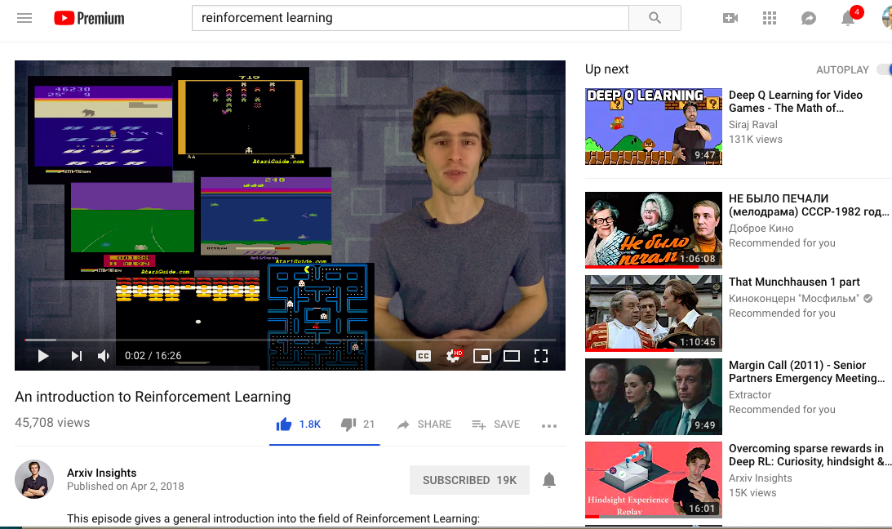
Xander Steenbrugge (Arxiv Insights on youtube)

Slide 6
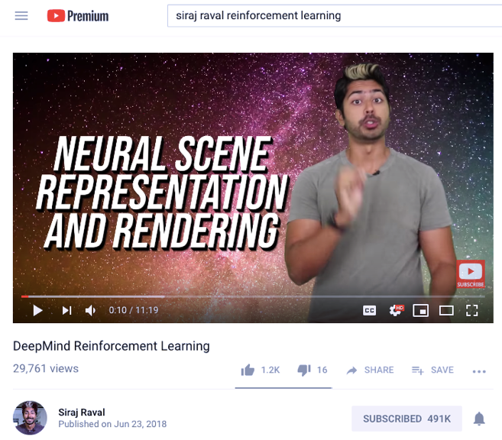
Siraj Raval on youtube - ~500K subscribers

Slide 7
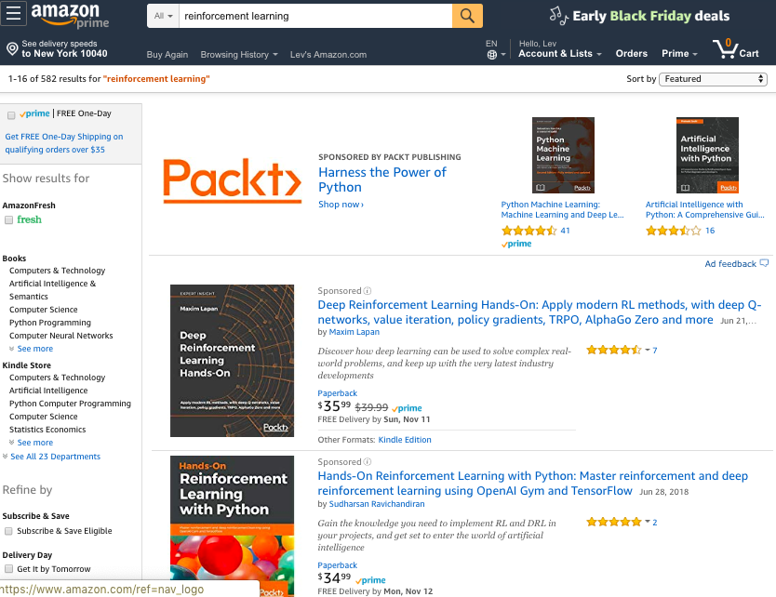
Reinforcement Learning – books on Amazon

Slide 8
Sam Charrington
This Week in Machine Learning & AI (TWiML&AI) podcast
- https://twimlai.com -

Slide 9
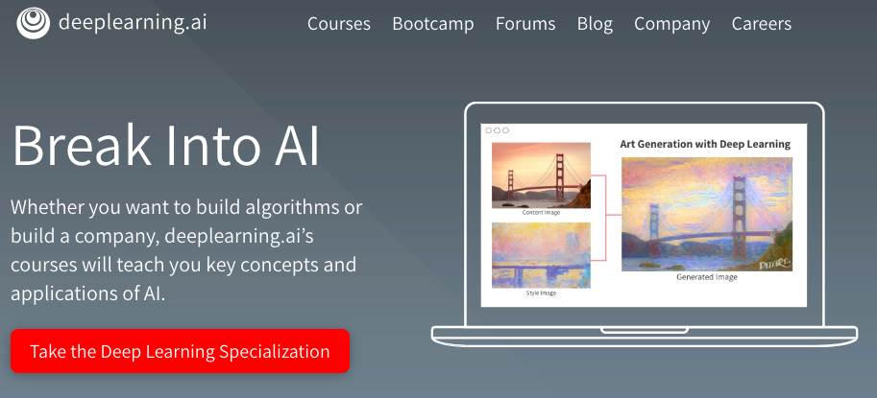
DeepLearning.ai – Coursera course by Andrew Ng

Slide 10

PyPy
A fast, compliant alternative implementation of Python.
Uses JIT (Just In Time compiler)
https://www.pypy.org/
https://www.pypy.org/download.html
https://speed.pypy.org/

